Slide 1
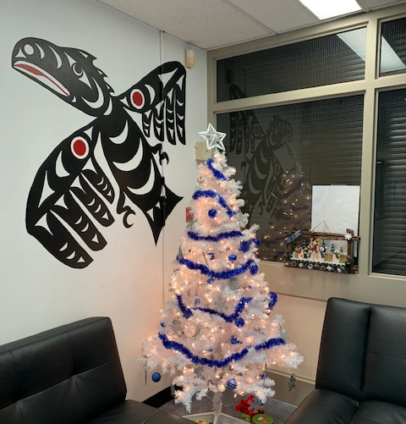
December Artwork & Activities
Hillside Traditional Academy

Slide 2
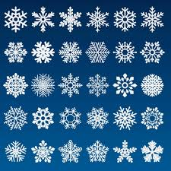
Division 12

Slide 3
Division 12

Slide 4
Division 5

Slide 5
Division 19

Slide 6
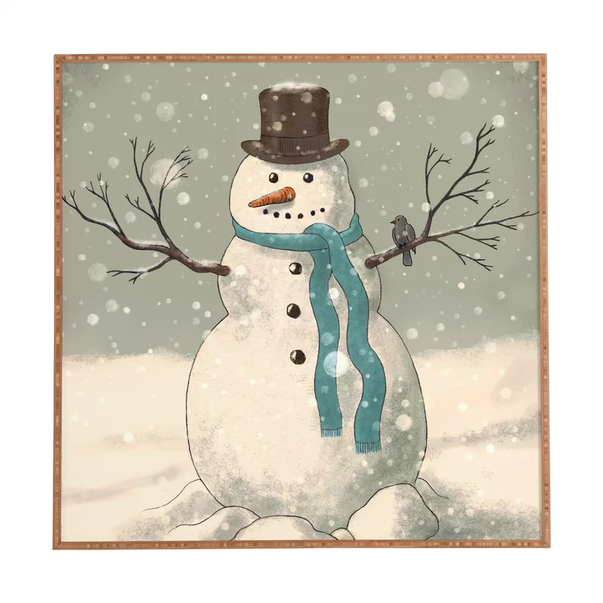
Division 19

Slide 7
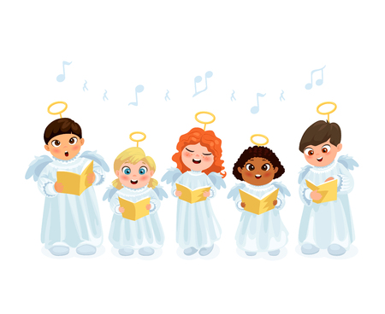
Division 18

Slide 8
Division 16

Slide 9
Division 14

Slide 10
Division 14

Slide 11
Division 17

Slide 12
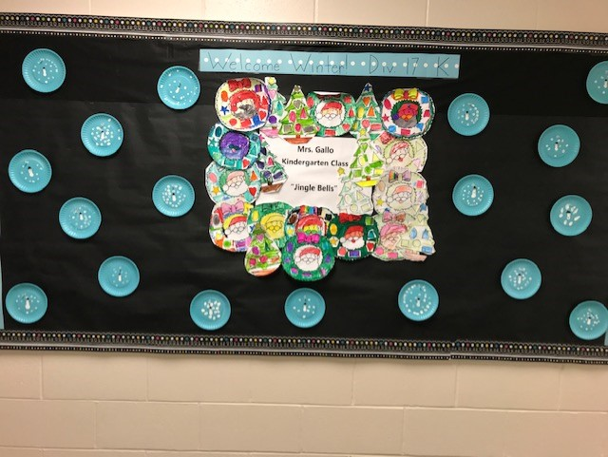
Division 17

Slide 13
Division 10 ~ Midnight in Winter

Slide 14
Division 10 ~ Midnight in Winter

Slide 15
Division 10 ~ Midnight in Winter

Slide 16
Division 10 ~ Midnight in Winter

Slide 17
Division 6

Slide 18
Division 6

Slide 19
Division 3

Slide 20
Division 3
When the snow falls,
Nature listens.

Slide 21
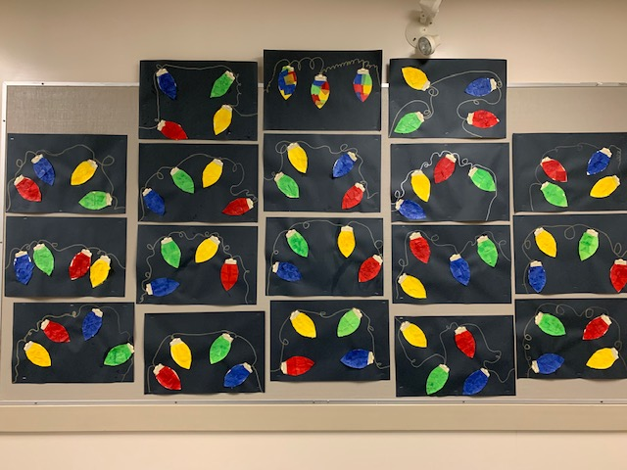
Division 13

Slide 22
Division 13

Slide 23
Division 4

Slide 24
ADST with Mrs. Blades

Slide 25
ADST with Mrs. Blades

Slide 26
Divisions 14 & 15

Slide 27
Division 9

Slide 28
Division 1

Slide 29
Crazy Mask Day

Slide 30
Crazy Mask Day

Slide 31
Crazy Mask Day

Slide 32
Crazy Mask Day

Slide 33
Crazy Mask Day

Slide 34
Crazy Mask Day

Slide 35
Festive Gear Day

Slide 36
Festive Gear Day

Slide 37
Festive Gear Day

Slide 38
Have a wonderful winter break!

